Slide 1

Classification MEthods
Chapter 04 (part 02)
Notes:
Logistic regression involves directly modeling Pr(Y = k|X = x) using the logistic function. In statistical jargon, we model the conditional distribution of the response Y , given the predictor(s) X. We now consider an alternative and less direct approach to estimating these probabilities. In this alternative approach, we model the distribution of the predictors X separately in each of the response classes (i.e. given Y ), and then use Bayes’ theorem to flip these around into estimates for Pr(Y = k|X = x). When these distributions are assumed to be normal, it turns out that the model is very similar in form to logistic regression.

Slide 2
Outline
Overview of LDA
Why not Logistic Regression?
Estimating Bayes’ Classifier
LDA Example with One Predictor (p=1)
LDA Example with more than One Predictor (P>1)
LDA on Default Data
Overview of QDA
Comparison between LDA and QDA
Notes:
In this lecture we’ll review both linear and quadradic discriminant analysis and contrast it with logistic regression

Slide 3
Linear Discriminant Analysis
LDA undertakes the same task as Logistic Regression. It classifies data based on categorical variables
Making profit or not
Buy a product or not
Satisfied customer or not
Political party voting intention
Notes:
LDA undertakes the same task as Logistic Regression. It classifies data based on categorical variables
Making profit or not
Buy a product or not
Satisfied customer or not
Political party voting intention

Slide 4
Why Linear? Why Discriminant?
LDA involves the determination of linear equation (just like linear regression) that will predict which group the case belongs to.
D: discriminant function
v: discriminant coefficient or weight for the variable
X: variable
a: constant
Notes:
LDA involves the determination of linear equation (just like linear regression) that will predict which group the case belongs to.
D: discriminant function
v: discriminant coefficient or weight for the variable
X: variable
a: constant

Slide 5
Purpose of LDA
Choose the v’s in a way to maximize the distance between the means of different categories
Good predictors tend to have large v’s (weight)
We want to discriminate between the different categories
Think of food recipe. Changing the proportions (weights) of the ingredients will change the characteristics of the finished cakes. Hopefully that will produce different types of cake!
Notes:
Choose the v’s in a way to maximize the distance between the means of different categories
Good predictors tend to have large v’s (weight)
We want to discriminate between the different categories
Think of food recipe. Changing the proportions (weights) of the ingredients will change the characteristics of the finished cakes. Hopefully that will produce different types of cake!

Slide 6
Assumptions of LDA
The observations are a random sample
Each predictor variable is normally distributed
Notes:
To reiterate, the LDA classifier results from assuming that the observations within each class come from a normal distribution with a class-specific mean vector and a common variance σ2, and plugging estimates for these parameters into the Bayes classifier. In Section 4.4.4, we will consider a less stringent set of assumptions, by allowing the observations in the kth class to have a class-specific variance, σ _{k} ²

Slide 7
Why not Logistic Regression?
Logistic regression is unstable when the classes are well separated
In the case where n is small, and the distribution of predictors X is approximately normal, then LDA is more stable than Logistic Regression
LDA is more popular when we have more than two response classes
Notes:
Why do we need another method, when we have logistic regression? There are several reasons:
When the classes are well-separated, the parameter estimates for the logistic regression model are surprisingly unstable. Linear discriminant analysis does not suffer from this problem.
If n is small and the distribution of the predictors X is approximately normal in each of the classes, the linear discriminant model is again more stable than the logistic regression model.
linear discriminant analysis is popular when we have more than two response classes.

Slide 8
Bayes’ Classifier
Bayes’ classifier is the golden standard. Unfortunately, it is unattainable.
So far, we have estimated it with two methods:
KNN classifier
Logistic Regression
Notes:
Bayes’ classifier is the golden standard. Unfortunately, it is unattainable.
So far, we have estimated it with two methods:
KNN classifier
Logistic Regression

Slide 9
Estimating Bayes’ Classifier
With Logistic Regression we modeled the probability of Y being from the k^{th} class as
=
However, Bayes’ Theorem states
=
: Probability of coming from class k (prior probability)
: Density function for X given that X is an observation from class k
Notes:
Suppose that we wish to classify an observation into one of K classes, where K ≥ 2. In other words, the qualitative response variable Y can take on K possible distinct and unordered values. Let πk represent the overall or prior probability that a randomly chosen observation comes from the kth class; this is the probability that a given observation is associated with the kth category of the response variable Y . Let fk( ) ≡ Pr(X = x|Y = k) denote the density function of X for an observation that comes from the kth class. In other words, fk(x) is relatively large if there is a high probability that an observation in the kth class has X ≈ x, and fk(x) is small if it is very unlikely that an observation in the kth class has X ≈ x. Then Bayes’ theorem states that
This suggests that instead of directly computing pk(X) as in Section 4.3.1, we can simply plug in estimates of πk and fk(X) into (4.10). In general, estimating πk is easy if we have a random sample of Y s from the population: we simply compute the fraction of the training observations that belong to the kth class. However, estimating fk(X) tends to be more challenging, unless we assume some simple forms for these densities. We refer to pk(x) as the posterior probability that an observation posterior X = x belongs to the kth class. That is, it is the probability that the observation belongs to the kth class, given the predictor value for that observation.
We know from Chapter 2 that the Bayes classifier, which classifies an observation to the class for which pk(X) is largest, has the lowest possible error rate out of all classifiers. (This is of course only true if the terms in (4.10) are all correctly specified.) Therefore, if we can find a way to estimate fk(X), then we can develop a classifier that approximates the Bayes classifier. Such an approach is the topic of the following sections.

Slide 10
Estimate and
We can estimate and to compute
The most common model for is the Normal Density
Using the density, we only need to estimate three quantities to compute
Notes:
Suppose we assume that fk(x) is normal or Gaussian. In the one-dimensional setting, the normal density takes the form
where μk and σ2 k are the mean and variance parameters for the kth class. For now, let us further assume that σ2 1 = ... = σ2 K: that is, there is a shared variance term across all K classes, which for simplicity we can denote by σ2.

Slide 11
Use Training Data set for Estimation
The mean could be estimated by the average of all training observations from the k^{th} class.
The variance could be estimated as the weighted average of variances of all k classes.
And, is estimated as the proportion of the training observations that belong to the k^{th} class.
Notes:
In practice, even if we are quite certain of our assumption that X is drawn from a Gaussian distribution within each class, we still have to estimate the parameters μ1,...,μK, π1,...,πK, and σ2. The linear discriminant analysis (LDA) method approximates the Bayes classifier by plugging estimates for πk, μk, and σ2. In particular, the following estimates are used:
The estimate for μ_{k} is simply the average of all the training observations from the kth class, while ˆσ2 can be seen as a weighted average of the sample variances for each of the K classes. Sometimes we have knowledge of the class membership probabilities π1,...,πK, which can be used directly. In the absence of any additional information, LDA estimates πk using the proportion of the training observations that belong to the kth class. In other words, πˆk = n_{k}/n.

Slide 12
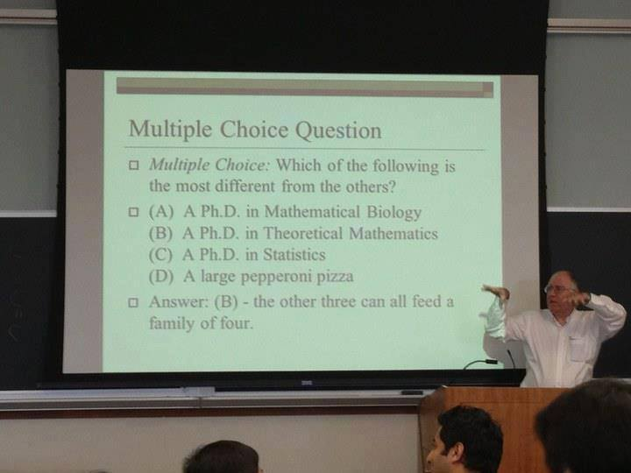
Notes:
Tell joke about theoretical mathematics

Slide 13
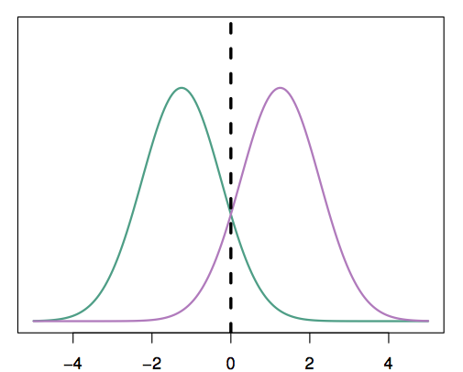
A Simple Example with One Predictor (p =1)
Suppose we have only one predictor (p = 1)
Two normal density function f₁(x) and f₂(x), represent two distinct classes
The two density functions overlap, so there is some uncertainty about the class to which an observation with an unknown class belongs
The dashed vertical line represents Bayes’ decision boundary
Notes:
For now, assume that p = 1—that is, we have only one predictor. We would like to obtain an estimate for fk(x) in order to estimate pk(x). We will then classify an observation to the class for which pk(x) is greatest. In order to estimate fk(x), we will first make some assumptions about its form.
An example is shown in the figure. The two normal density functions that are displayed, f1(x) and f2(x), represent two distinct classes. The mean and variance parameters for the two density functions are μ₁ = −1.25, μ₂ = 1.25, and σ₁² = σ₂² = 1. The two densities overlap, and so given that X = x, there is some uncertainty about the class to which the observation belongs. If we assume that an observation is equally likely to come from either class—that is, π₁ = π₂ = 0.5—then we see that the Bayes classifier assigns the observation to class 1 if x < 0 and class 2 otherwise. Note that in this case, we can compute the Bayes classifier because we know that X is drawn from a Gaussian distribution within each class, and we know all of the parameters involved. In a real-life situation, we are not able to calculate the Bayes classifier.

Slide 14
Apply LDA
LDA starts by assuming that each class has a normal distribution with a common variance
The mean and the variance are estimated
Finally, Bayes’ theorem is used to compute p_{k} and the observation is assigned to the class with the maximum probability among all k probabilities
Notes:
LDA starts by assuming that each class has a normal distribution with a common variance
The mean and the variance are estimated
Then use Bayes’ theorem is used to compute p_{k} and the observation is assigned to the class with the maximum probability among all k probabilities
The LDA classifier plugs the estimates and assigns an observation X = x to the class for which it’s objective function is largest. The word linear in the classifier’s name stems from the fact that the discriminant functions are linear functions of x (as discriminant opposed to a more complex function of x).

Slide 15
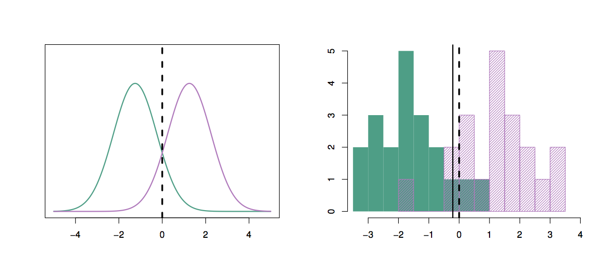
Apply LDA
20 observations were drawn from each of the two classes
The dashed vertical line is the Bayes’ decision boundary
The solid vertical line is the LDA decision boundary
Bayes’ error rate: 10.6%
LDA error rate: 11.1%
Notes:
The right-hand panel of this Figure displays a histogram of a random sample of 20 observations from each class. To implement LDA, we began by estimating πk, μk, and σ2. We then computed the decision boundary, all points to the left of this line will be assigned to the green class, while points to the right of this line are assigned to the purple class. In this case, since n1 = n2 = 20, we have ˆπ1 = ˆπ2. As a result, the decision boundary corresponds to the midpoint between the sample means for the two classes. The figure indicates that the LDA decision boundary is slightly to the left of the optimal Bayes decision boundary, which instead equals (μ1 + μ2)/2 = 0. How well does the LDA classifier perform on this data? Since this is simulated data, we can generate a large number of test observations in order to compute the Bayes error rate and the LDA test error rate. These are 10.6 % and 11.1 %, respectively. In other words, the LDA classifier’s error rate is only 0.5 % above the smallest possible error rate! This indicates that LDA is performing pretty well on this data set.

Slide 16
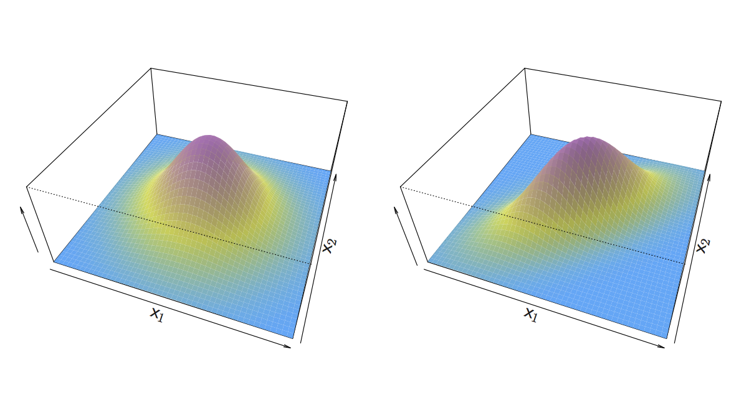
An Example When p > 1
If X is multidimensional (p > 1), we use exactly the same approach except the density function f(x) is modeled using the multivariate normal density
Notes:
We now extend the LDA classifier to the case of multiple predictors. To do this, we will assume that X = (X1, X2,...,Xp) is drawn from a multivariate Gaussian (or multivariate normal) distribution, with a class-specific multivariate mean vector and a common covariance matrix.
The multivariate Gaussian distribution assumes that each individual predictor follows a one-dimensional normal distribution with some correlation between each pair of predictors. Two examples of multivariate Gaussian distributions with p = 2 are shown in the Figure on this slide. The height of the surface at any particular point represents the probability that both X1 and X2 fall in a small region around that point. In either panel, if the surface is cut along the X1 axis or along the X2 axis, the resulting cross-section will have the shape of a one-dimensional normal distribution. The left-hand panel of Figure illustrates an example in which Var(X1) = Var(X2) and Cor(X1, X2) = 0; this surface has a characteristic bell shape. However, the bell shape will be distorted if the predictors are correlated or have unequal variances, as is illustrated in the right-hand panel of the Figure. In this situation, the base of the bell will have an elliptical, rather than circular, shape.
In the case of p > 1 predictors, the LDA classifier assumes that the observations in the kth class are drawn from a multivariate Gaussian distribution, with a class-specific mean vector, and a variance/covariance matrix that is common to all K classes.

Slide 17
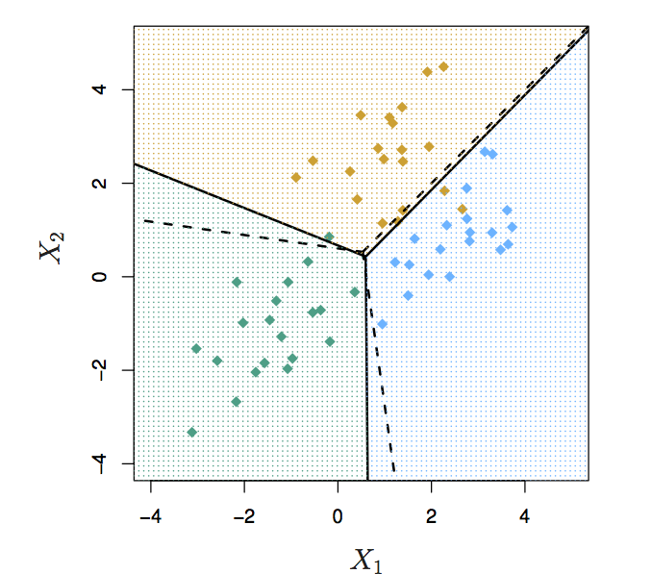
An Example When p > 1
We have two predictors (p =2)
Three classes
20 observations from each class
The solid lines are Bayes’ boundaries
The dashed lines are LDA boundaries
Notes:
In the Figure here, 20 observations drawn from each of three classes are displayed, and the resulting LDA decision boundaries are shown as solid black lines. Overall, the LDA decision boundaries are pretty close to the Bayes decision boundaries, shown as dashed lines. The test error rates for the Bayes and LDA classifiers are 0.0746 and 0.0770, respectively. This indicates that LDA is performing well on this data.
We can perform LDA on the Default data in order to predict whether or not an individual will default on the basis of credit card balance and student status. The LDA model fit to the 10, 000 training samples results in a training error rate of 2.75 %. This sounds like a low error rate, but two caveats must be noted.
First of all, training error rates will usually be lower than test error rates, which are the real quantity of interest. In other words, we might expect this classifier to perform worse if we use it to predict whether or not a new set of individuals will default. The reason is that we specifically adjust the parameters of our model to do well on the training data. The higher the ratio of parameters p to number of samples n, the more we expect this overfitting to play a role. For overfitting these data we don’t expect this to be a problem, since p = 2 and n = 10, 000.
Second, since only 3.33 % of the individuals in the training sample defaulted, a simple but useless classifier that always predicts that each individual will not default, regardless of his or her credit card balance and student status, will result in an error rate of 3.33 %. In other words, the trivial null classifier will achieve an error rate that is only a bit higher than the LDA training set error rate.

Slide 18
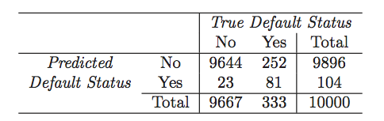
Running LDA on Default Data
LDA makes 252+ 23 mistakes on 10000 predictions (2.75% misclassification error rate)
But LDA miss-predicts 252/333 = 75.5% of defaulters!
Perhaps, we shouldn’t use 0.5 as threshold for predicting default?
Notes:
In practice, a binary classifier such as this one can make two types of errors: it can incorrectly assign an individual who defaults to the no default category, or it can incorrectly assign an individual who does not default to the default category. It is often of interest to determine which of these two types of errors are being made. A confusion matrix, shown for the Default data in Table 4.4, is a convenient way to display this information. The table reveals that LDA predicted that a total of 104 people would default. Of these people, 81 actually defaulted and 23 did not. Hence only 23 out of 9, 667 of the individuals who did not default were incorrectly labeled. This looks like a pretty low error rate! However, of the 333 individuals who defaulted, 252 (or 75.7 %) were missed by LDA. So while the overall error rate is low, the error rate among individuals who defaulted is very high. From the perspective of a credit card company that is trying to identify high-risk individuals, an error rate of 252/333 = 75.7% among individuals who default may well be unacceptable.
Class-specific performance is also important in medicine and biology, where the terms sensitivity and specificity characterize the performance of a classifier or screening test. In this case the sensitivity is the percentage of true defaulters that are identified, a low 24.3 % in this case. The specificity is the percentage of non-defaulters that are correctly identified, here (1 − 23/9, 667) × 100 = 99.8 %.

Slide 19
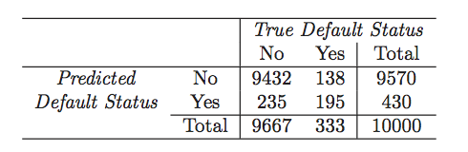
Use 0.2 as Threshold for Default
Now the total number of mistakes is 235+138 = 373 (3.73% misclassification error rate)
But we only miss-predicted 138/333 = 41.4% of defaulters
We can examine the error rate with other thresholds
Notes:
Why does LDA do such a poor job of classifying the customers who default? In other words, why does it have such a low sensitivity? As we have seen, LDA is trying to approximate the Bayes classifier, which has the lowest total error rate out of all classifiers (if the Gaussian model is correct). That is, the Bayes classifier will yield the smallest possible total number of misclassified observations, irrespective of which class the errors come from. That is, some misclassifications will result from incorrectly assigning a customer who does not default to the default class, and others will result from incorrectly assigning a customer who defaults to the non-default class. In contrast, a credit card company might particularly wish to avoid incorrectly classifying an individual who will default, whereas incorrectly classifying an individual who will not default, though still to be avoided, is less problematic. We will now see that it is possible to modify LDA in order to develop a classifier that better meets the credit card company’s needs.
The Bayes classifier works by assigning an observation to the class for which the posterior probability pk(X) is greatest. In the two-class case, this amounts to assigning an observation to the default class if Pr(default = Yes|X = x) > 0.5. Thus, the Bayes classifier, and by extension LDA, uses a threshold of 50 % for the posterior probability of default in order to assign an observation to the default class. However, if we are concerned about incorrectly predicting the default status for individuals who default, then we can consider lowering this threshold. For instance, we might label any customer with a posterior probability of default above 20 % to the default class. In other words, instead of assigning an observation to the default class if holds, we could instead assign an observation to this class if Pr(default = Yes|X = x) > 0.2.
The error rates that result from taking this approach are shown in Table. Now LDA predicts that 430 individuals will default. Of the 333 individuals who default, LDA correctly predicts all but 138, or 41.4%. This is a vast improvement over the error rate of 75.7% that resulted from using the threshold of 50%. However, this improvement comes at a cost: now 235 individuals who do not default are incorrectly classified. As a result, the overall error rate has increased slightly to 3.73 %. But a credit card company may consider this slight increase in the total error rate to be a small price to pay for more accurate identification of individuals who do indeed default.

Slide 20
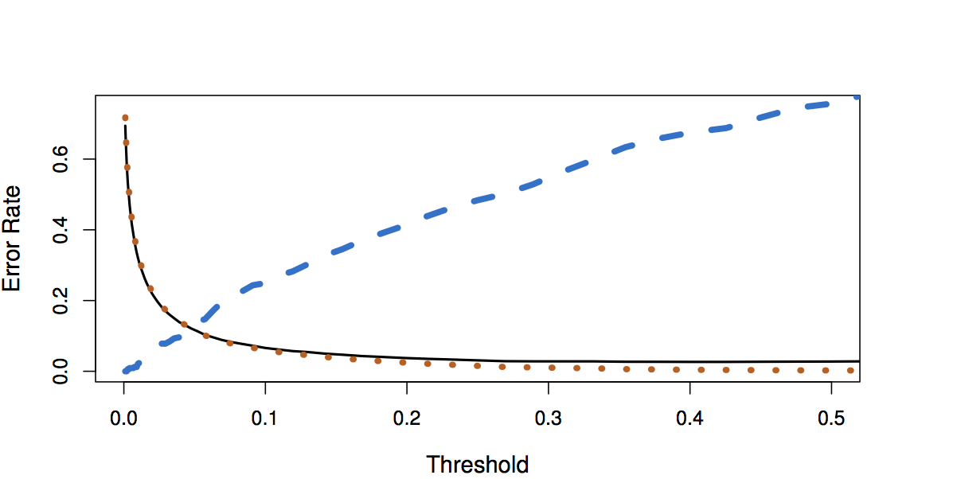
Default Threshold Values vs. Error Rates
Black solid: overall error rate
Blue dashed: Fraction of defaulters missed
Orange dotted: non defaulters incorrectly classified
Notes:
Figure 4.7 illustrates the trade-off that results from modifying the threshold value for the posterior probability of default. Various error rates are shown as a function of the threshold value. Using a threshold of 0.5, as in (4.21), minimizes the overall error rate, shown as a black solid line. This is to be expected, since the Bayes classifier uses a threshold of 0.5 and is known to have the lowest overall error rate. But when a threshold of 0.5 is used, the error rate among the individuals who default is quite high (blue dashed line). As the threshold is reduced, the error rate among individuals who default decreases steadily, but the error rate among the individuals who do not default increases. How can we decide which threshold value is best? Such a decision must be based on domain knowledge, such as detailed information about the costs associated with default.

Slide 21
Quadratic Discriminant Analysis (QDA)
LDA assumed that every class has the same variance/ covariance
However, LDA may perform poorly if this assumption is far from true
QDA works identically as LDA except that it estimates separate variances/ covariance for each class
Notes:
As we have discussed, LDA assumes that the observations within each class are drawn from a multivariate Gaussian distribution with a classspecific mean vector and a covariance matrix that is common to all K classes. Quadratic discriminant analysis (QDA) provides an alternative quadratic discriminant analysis approach. Like LDA, the QDA classifier results from assuming that the observations from each class are drawn from a Gaussian distribution, and plugging estimates for the parameters into Bayes’ theorem in order to perform prediction. However, unlike LDA, QDA assumes that each class has its own covariance matrix. That is, it assumes that an observation from the kth class is of the form X ∼ N(μk, Σk), where Σk is a covariance matrix for the kth class. Under this assumption, the Bayes classifier assigns an observation X = x to the class for which is largest. So the QDA classifier involves plugging estimates for Σk, μk, and πk into (4.23), and then assigning an observation X = x to the class for which this quantity is largest. Unlike in (4.19), the quantity x appears as a quadratic function in (4.23). This is where QDA gets its name.

Slide 22
Which is better? LDA or QDA?
Since QDA allows for different variances among classes, the resulting boundaries become quadratic
Which approach is better: LDA or QDA?
QDA will work best when the variances are very different between classes and we have enough observations to accurately estimate the variances
LDA will work best when the variances are similar among classes or we don’t have enough data to accurately estimate the variances
Notes:
Why does it matter whether or not we assume that the K classes share a common covariance matrix? In other words, why would one prefer LDA to QDA, or vice-versa? The answer lies in the bias-variance trade-off. When there are p predictors, then estimating a covariance matrix requires estimating p(p+1)/2 parameters. QDA estimates a separate covariance matrix for each class, for a total of Kp(p+1)/2 parameters. With 50 predictors this is some multiple of 1,275, which is a lot of parameters. By instead assuming that the K classes share a common covariance matrix, the LDA model becomes linear in x, which means there are Kp linear coefficients to estimate. Consequently, LDA is a much less flexible classifier than QDA, and so has substantially lower variance. This can potentially lead to improved prediction performance. But there is a trade-off: if LDA’s assumption that the K classes share a common covariance matrix is badly off, then LDA can suffer from high bias. Roughly speaking, LDA tends to be a better bet than QDA if there are relatively few training observations and so reducing variance is crucial. In contrast, QDA is recommended if the training set is very large, so that the variance of the classifier is not a major concern, or if the assumption of a common covariance matrix for the K classes is clearly untenable.

Slide 23
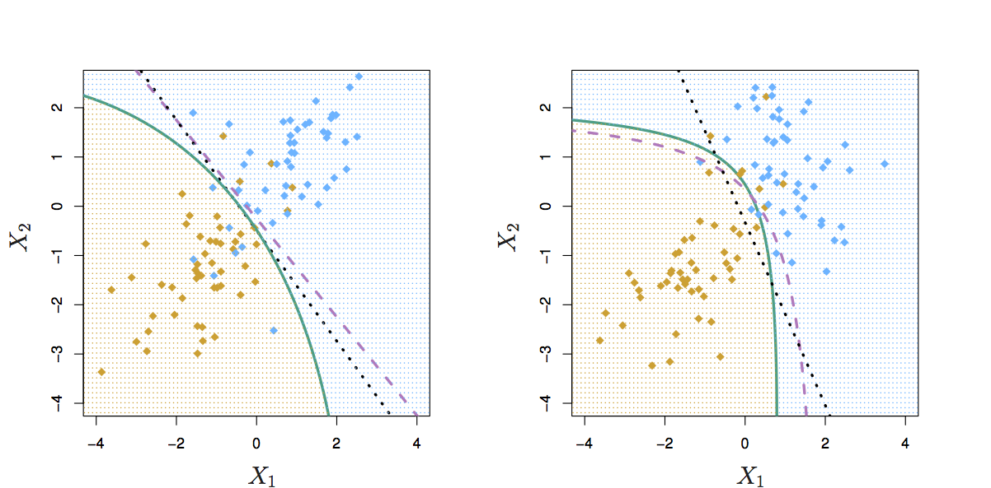
Comparing LDA to QDA
variances of the classes are equal
LDA is better fit
variances of the classes are not equal QDA is better fit
Black dotted: LDA boundary
Purple dashed: Bayes’ boundary
Green solid: QDA boundary
Notes:
Figure 4.9 illustrates the performances of LDA and QDA in two scenarios. In the left-hand panel, the two Gaussian classes have a common correlation of 0.7 between X1 and X2. As a result, the Bayes decision boundary is linear and is accurately approximated by the LDA decision boundary. The QDA decision boundary is inferior, because it suffers from higher variance without a corresponding decrease in bias. In contrast, the right-hand panel displays a situation in which the orange class has a correlation of 0.7 between the variables and the blue class has a correlation of −0.7. Now the Bayes decision boundary is quadratic, and so QDA more accurately approximates this boundary than does LDA.

Slide 24
Comparison of Classification Methods
KNN (Chapter 2)
Logistic Regression (Chapter 4)
LDA (Chapter 4)
QDA (Chapter 4)
Notes:
In this chapter, we have considered three different classification approaches: logistic regression, LDA, and QDA. In Chapter 2, we also discussed the K-nearest neighbors (KNN) method. We now consider the types of scenarios in which one approach might dominate the others.

Slide 25
Logistic Regression vs. LDA
Similarity : Both Logistic Regression and LDA produce linear boundaries
Difference : LDA assumes that the observations are drawn from the normal distribution with common variance in each class, while logistic regression does not have this assumption. LDA would do better than Logistic Regression if the assumption of normality hold, otherwise logistic regression can outperform LDA
Notes:
Though their motivations differ, the logistic regression and LDA methods are closely connected,
both logistic regression and LDA produce linear decision boundaries. The only difference between the two approaches lies in the fact that β0 and β1 are estimated using maximum likelihood, whereas c0 and c1 are computed using the estimated mean and variance from a normal distribution. This same connection between LDA and logistic regression also holds for multidimensional data with p > 1.
Since logistic regression and LDA differ only in their fitting procedures, one might expect the two approaches to give similar results. This is often, but not always, the case. LDA assumes that the observations are drawn from a Gaussian distribution with a common covariance matrix in each class, and so can provide some improvements over logistic regression when this assumption approximately holds. Conversely, logistic regression can outperform LDA if these Gaussian assumptions are not met.

Slide 26
KNN vs. (LDA and Logistic Regression)
KNN takes a completely different approach
KNN is completely non-parametric: No assumptions are made about the shape of the decision boundary!
Advantage of KNN: We can expect KNN to dominate both LDA and Logistic Regression when the decision boundary is highly non-linear
Disadvantage of KNN: KNN does not tell us which predictors are important (no table of coefficients)
Notes:
KNN takes a completely different approach from the classifiers seen in this chapter. In order to make a prediction for an observation X = x, the K training observations that are closest to x are identified. Then X is assigned to the class to which the plurality of these observations belong. Hence KNN is a completely non-parametric approach: no assumptions are made about the shape of the decision boundary. Therefore, we can expect this approach to dominate LDA and logistic regression when the decision boundary is highly non-linear. On the other hand, KNN does not tell us which predictors are important; we don’t get a table of coefficients.

Slide 27
QDA vs. (LDA, Logistic Regression, and KNN)
QDA is a compromise between non-parametric KNN method and the linear LDA and logistic regression
If the true decision boundary is:
Linear: LDA and Logistic outperforms
Moderately Non-linear: QDA outperforms
More complicated: KNN is superior
Notes:
Finally, QDA serves as a compromise between the non-parametric KNN method and the linear LDA and logistic regression approaches. Since QDA assumes a quadratic decision boundary, it can accurately model a wider range of problems than can the linear methods. Though not as flexible as KNN, QDA can perform better in the presence of a limited number of training observations because it does make some assumptions about the form of the decision boundary.

